Slide 1



Bluetooth Proximity Alarm
By: Tushar Patil
A254

Slide 2
Contents
Project Information
Components Used
Circuit Diagram
Connections
Code
Operation

Slide 3
Project Information
The Bluetooth Proximity Alarm is a project designed to create a system that alerts you when a Bluetooth-connected device moves out of range.
This project combines hardware and software components to simulate the behavior of a proximity alarm system.
Simulation of this project is done on online ide Wokwi

Slide 4
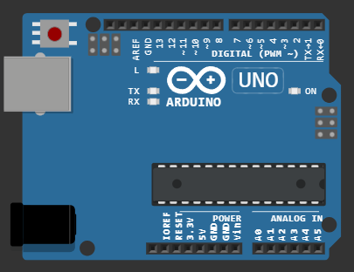
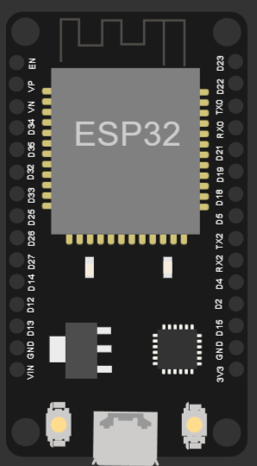
Components Used
Arduino Uno: The central control unit that manages the operation of the system. It handles the buzzer and button controls.
ESP32 Module: A Bluetooth module responsible for managing Bluetooth communication and simulating signal strength data. In this project, it acts as the Bluetooth receiver.

Slide 5


Buzzer: A small piezo buzzer or speaker used to generate an audible alarm sound when triggered.
Button: A simple momentary push-button switch used to simulate a device coming in Bluetooth range

Slide 6
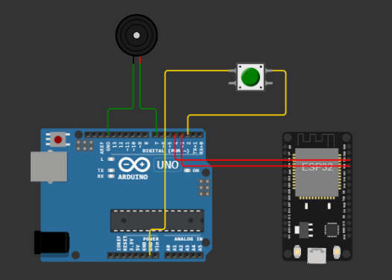
Circuit

Slide 7
Connections
Buzzer
One leg of the buzzer is connected to a digital pin on the Arduino Uno (e.g., pin 7).
Other leg of the buzzer is connected to the ground (GND) on the Arduino Uno.
Button
One leg of the button is connected to a digital pin on the Arduino Uno (e.g., pin 4).
Other leg of the button is connected to the ground (GND) on the Arduino Uno. This effectively connects a pull-down resistor.
ESP32 & Arduino UNO
RX (Receive) pin of the ESP32 is connected to a digital pin on the Arduino Uno (e.g., pin 3) using a virtual wire.
TX (Transmit) pin of the ESP32 is connected to another digital pin on the Arduino Uno (e.g., pin 4) using a virtual wire.

Slide 8
Code
#include <SoftwareSerial.h>
SoftwareSerial esp32Serial(3, 4); // RX, TX pins for ESP32 module
int buzzerPin = 7;
int buttonPin = 4; // Connect the button to digital pin 4 on the Arduino Uno
int signalStrengthThreshold = -60; // Adjust this value based on your setup
bool isAlarmActive = false;
void setup() {
Serial.begin(9600);
esp32Serial.begin(9600);
pinMode(buzzerPin, OUTPUT);
pinMode(buttonPin, INPUT_PULLUP); // Internal pull-up resistor
}
void loop() {
int buttonState = digitalRead(buttonPin);
if (buttonState == LOW) {
if (!isAlarmActive) {
esp32Serial.print("S:"); // Simulate sending signal strength data
esp32Serial.println(random(-100, -50)); // Simulate signal strength
isAlarmActive = true;

Slide 9
}
} else {
isAlarmActive = false;
}
while (esp32Serial.available()) {
char c = esp32Serial.read();
Serial.print(c);
if (c == 'S' && esp32Serial.peek() == ':') {
esp32Serial.read(); // Consume ':'
int signalStrength = esp32Serial.parseInt();
if (signalStrength < signalStrengthThreshold) {
digitalWrite(buzzerPin, HIGH);
delay(500);
digitalWrite(buzzerPin, LOW);
}
}
}
}

Slide 10
Operation
Button Press:
When the button is pressed, it simulates a drop in signal strength, as if the Bluetooth-connected device is moving out of range.
Alarm Trigger:
If the simulated signal strength falls below a predefined threshold, the alarm (buzzer) is triggered.

Slide 11
Conclusion
The Bluetooth Proximity Alarm project demonstrates the concept of a proximity alarm system using virtual components.
It highlights the importance of Bluetooth technology in modern tracking and security systems.

Slide 12
Thank You

